Slide 1
The development of Boron-containing Materials for
Boron Neutron Capture Therapy (BNCT)
Department of Chemistry at Tamkang University
Nov. 24th , 2020

Slide 2
Boron Neutron Capture Therapy (BNCT)
Thermal
Neutrons
5 μm
⁷Li
¹⁰B
9 μm
¹¹B
⁴He
Cancer Cell
Yamamoto, T.; Tsuboi, K.; Nakai, K.; Kumada, H.; Sakurai, H.; Matsumura, A. Transl. Cancer Res. 2013, 2, 80-86.
Notes:
In treatment of BNCT, boron-containing drugs is an important factor. Nowadays, there are two clinical trial used boron-containing agents for BNCT. The first one is BSH, it is an ionic product, and it is used to treat malignant glioblastoma. It a water-soluble drugs. However, the problem is, BSH is hard to penetrated the cell membrane due to it ionic charge characters.
The second one been the BPA, it is to used to treat malignant melanoma. However, it is not easy to soluble in water, therefore it need to complex with the fructose to use clinically.
Both of them have some advantage and have some drawback. For example, BSH is a multiple boron-containing agent were it can deliver high concentration of boron to the patients. However it has difficulty to penetrated the cell membrane due to its charges. As the BPA, it is easy to penetrated the cell membrane , however it only carries one boron in the molecule.
Therefore, we wondering if we can make the molecule just like BPA, but carry multiple boron elements that can easily penetrated the cell membrane.
(An ideal BNCT drugs except need the low toxicity, rapidly removed from the body's normal cells and blood, further must have high selectivity to tumor cell to reduce the damage from thermal neutron.
At present, FDA-approved available for clinical BNCT drugs only BSH and BPA.
BSH is the drug of malignant melanoma tumors. It’s a water-soluble drugs. And its can pass through the brain tumor patient’s Blood brain barrier(BBB), combined with tumor cells to achieve therapeutic purposes.
BPA is the drug of malignant melanoma. Its has the high solubility of fructose solution, can enhance tumor cell uptake ratio of boron. By the different absorbed of the subpopulation result BPA uneven distribution in tumor cell. And its can’t accumulate in the quiescent cell tumor cells. Makes treatment affected.
Thus, some research point that combine BPA and BSH can solve this problem, however increase the treatment time. Hence, develop a BNCT drugs has good results and can used for different tumor is very important.)

Slide 3
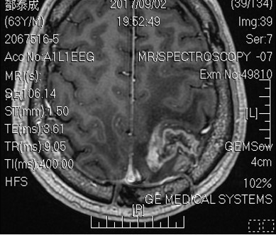
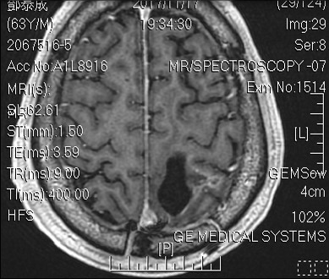
Boron Neutron Capture Therapy (BNCT)
Before BNCT
After BNCT
Provided by 台北榮總陳一瑋醫師
Notes:
As shown in the MRI data, GBM almost completely disappear after BNCT procedure.

Slide 4
Skin cancer is one of the top 10 cause of death in Taiwan
Skin cancer is a highly aging-correlated disease.
Skin cancer is primarily treated by the medical operation, in which
the quality of life of a patient is often sacrificed.

Slide 5
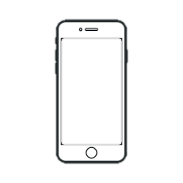

計畫主軸分工
研究主軸一：
含硼藥物的開發
研究主軸三：
藥物濃度即時監測系統
研究主軸一：
含硼藥物的開發
硼中子捕獲治療
研究主軸二：
微針藥物遞送系統
Notes:
Aim 1 of this project: The development of a boron drug by a highly (and patent) synthetic procedure.
Aim 2 of this project: The use of the 3-D printed micro-needle drug delivery system (first in class, and patent) to deliver boron drug.
Aim 3 of this project: The development of the “real-time”boron concentration determination liquid-crystal system to monitor the boron drug concentration in biological system.

Slide 6
Aim 1: Boron Drug Development
(a) Linear Approach
(c) Multicomponent Approach
(b) Convergent Approach
Alexander Domling, Wei Wang, Kan Wang Chem. Rev. 2012, 112, 3083
Notes:
優點[Benifit]
In the traditional synthesize method, is using
Linear approach or
(b) Convergent approach, which is synthesize step by steps. But in
(c) Multicomponent approach is adding three or more than three component in one pot,
This kinds of reaction is really an ideal synthesis, it’s have a lot of benefits, such as “Simple, Total conversion, safe, readily avalable starting material, Environmetally friendly, resource efficient, one pot, quantitative yield”So, we also can called the multicomponent reaction is green chemistry. In this project, we aim to use this strategy to synthesize boron-containing molecules.

Slide 7
Aim 1: Boron Drug Development
Notes:
The strategy we are going to apply in this project is called: Ugi multicomponent reaction, where four starting materials are combined in one-pot to synthesize the desired product. This strategy is highly efficient and allows us to construct the molecular library very quickly.

Slide 8
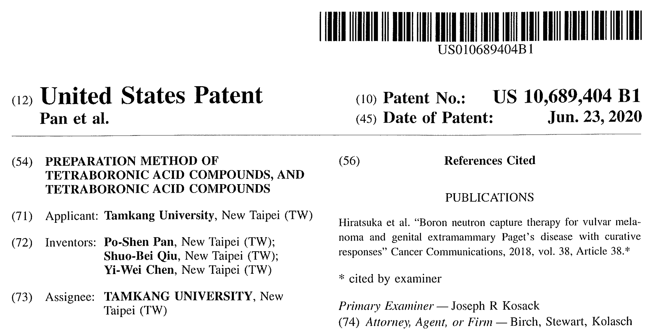
US Patent Granted-2020
Notes:
The synthetic procedure for the synthesis of boron-containing compounds has been patented (US) in 2020.

Slide 9
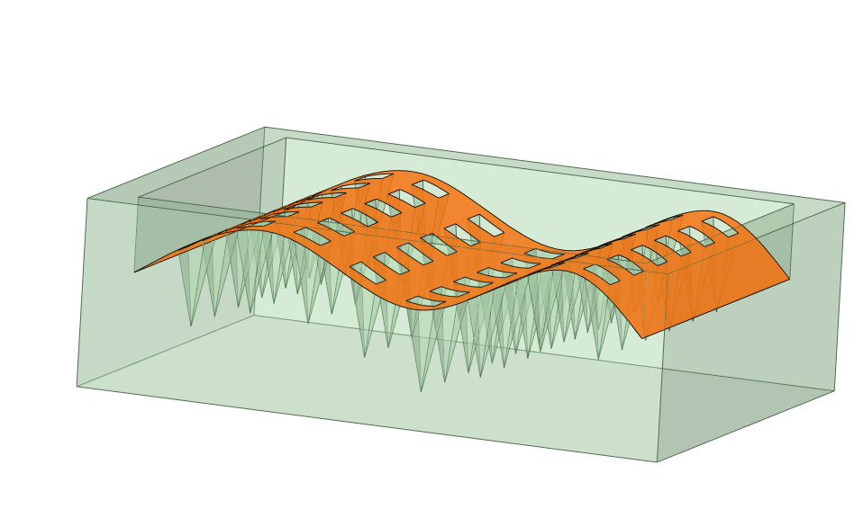
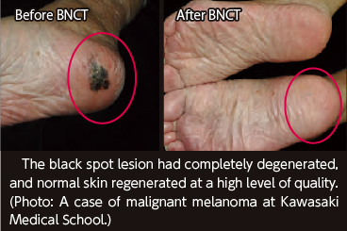
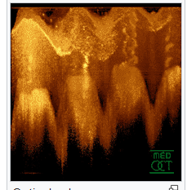


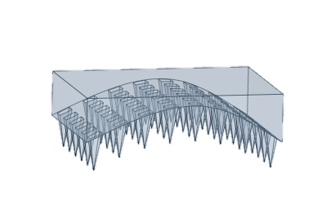
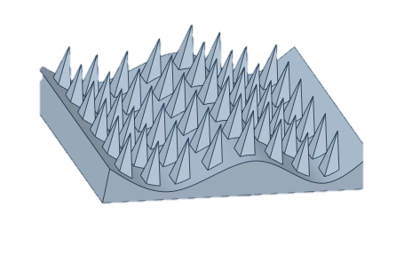
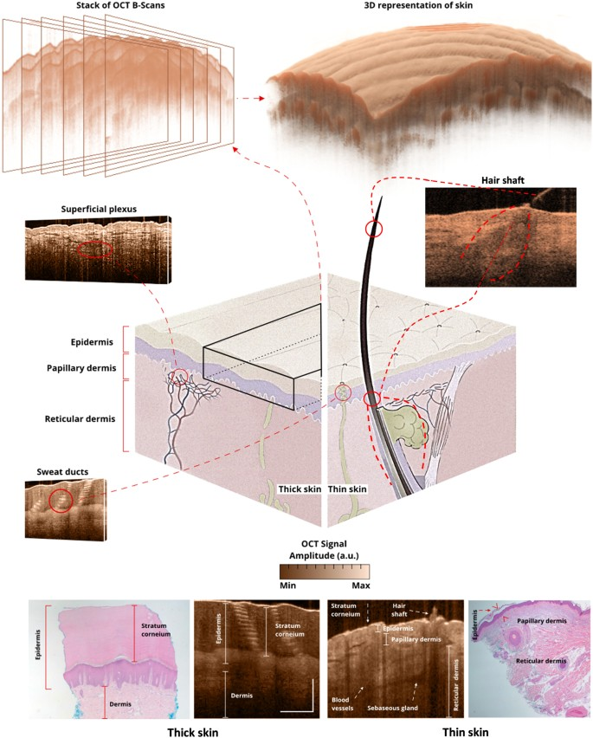

OCT sacnning
3-D model
construction by
Autocad.
Micro-needle
fabrication
by 3-D printing
Irradiation by thermal neutron
Micro-needle
patch
Boron-containing
Micro-needle patch

Slide 10
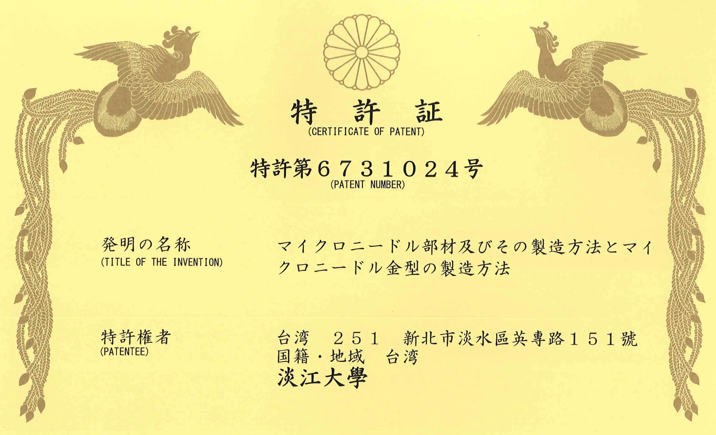
Japan Patent Granted-2020
Notes:
The fabrication of micro-needle process has been patented (Japan).

Slide 11
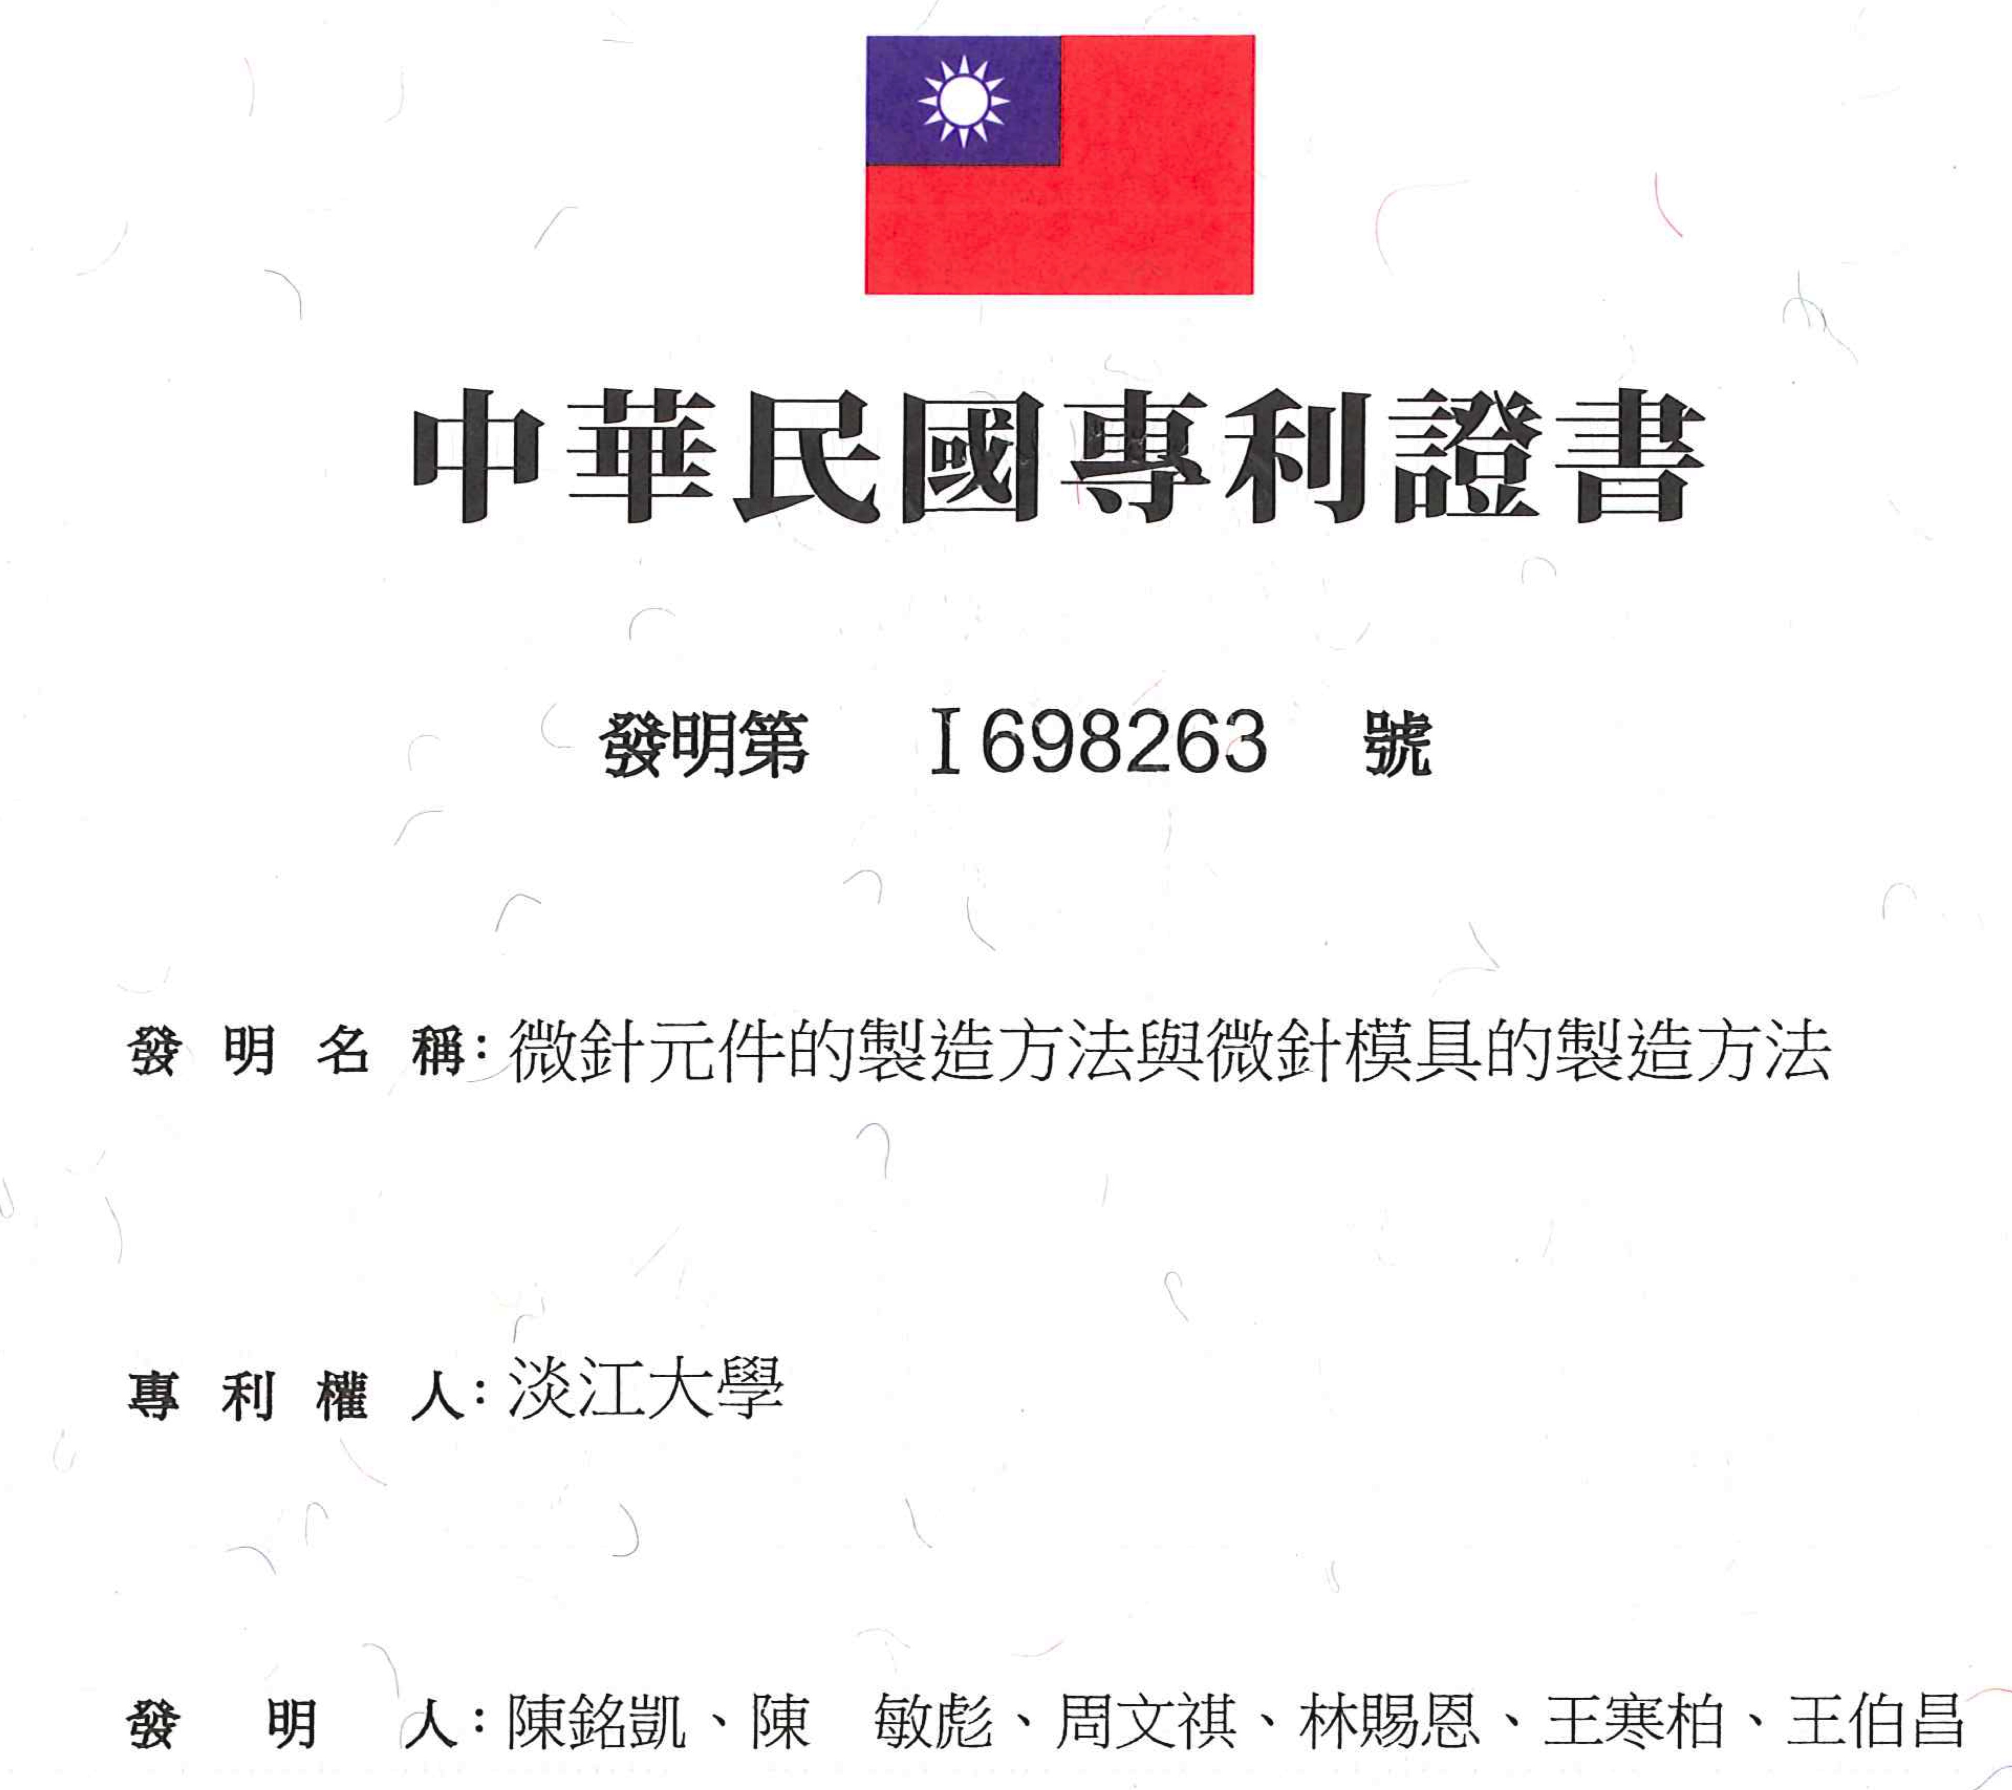
Taiwan Patent Granted-2020
Notes:
The fabrication of micro-needle process has been patented (Taiwan).

Slide 12
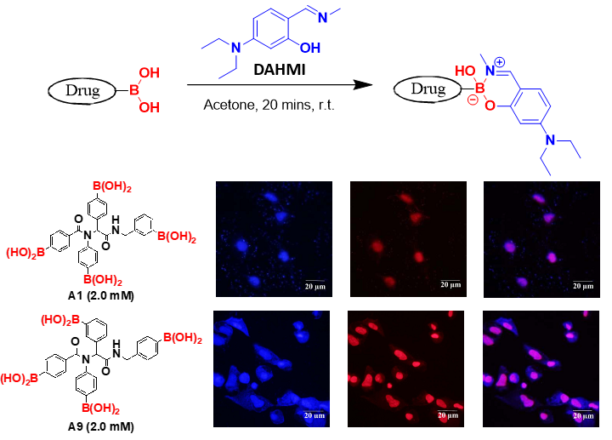
Detection Technology
Collaborated with Prof. MKC at Tamkang Univ.
Notes:
The detection system to be developed in Aim 3 is based on the preliminary data, where a fluorescent tag (DAHMI) probe can complex with the boronic acids to show florescent signal (in blue)

Slide 13
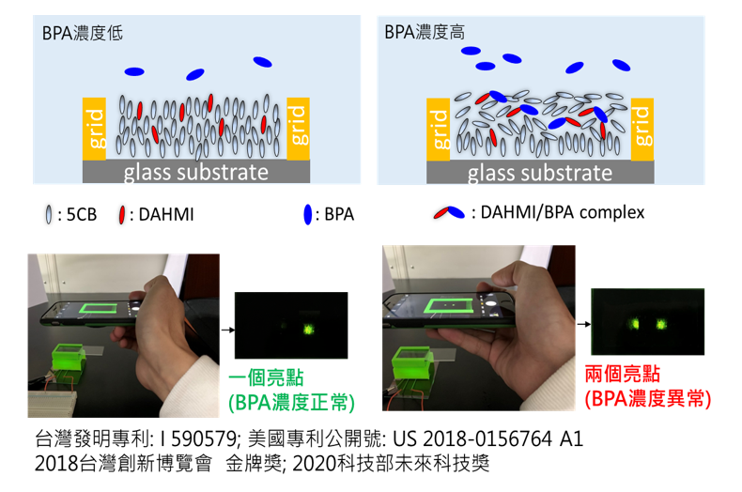
Liquid Crystal Based Boron Detection System

Slide 14
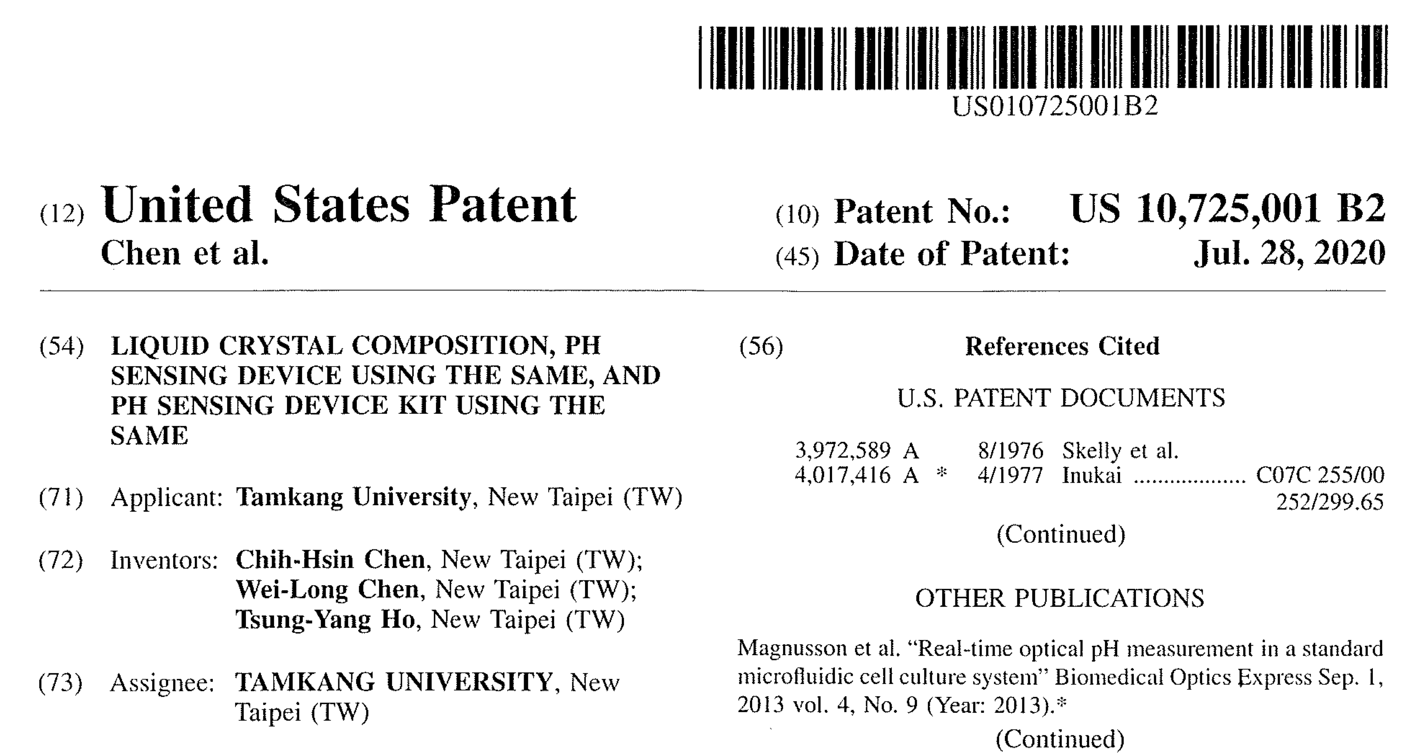
US Patent Granted-2020
Notes:
The LC-based detection system has been patented (US).

Slide 15
Proposal Summary
The Team
Aim 1(Boron Drug Develop.)：
Po-Shen Pan (Organic Synthesis)
蔡Min-Yeh Tsai (Theoretical Calc.)
計畫主軸二 (微針藥物遞送系統)：
Ming-Kai Chern (Micro-needle)
Yau-Hung Chen (Toxicology)
計畫主軸三 (藥物濃度即時監測系統)：Chih-Hsin Chen (LC-based Detection System)

Slide 16
Proposal Summary
Innovation
This project includes researchers from multiple fields that is unique and
advantageous. The proposed drug delivery system and the drug
detection system have not been reported or patented.
Scientific Significance
BNCT has been approved to treat head & neck cancer by Japan FDA in March, 2020. To expand the scope of BNCT to treat other cancer such
as skin cancer would be highly desirable.

Slide 17
Timeline of this Project
Toxicological Screening of Boron Drugs using
Zebrafish model
BNCT on
Skin Cancer Animal Model
L-BPA infused
Micro-needle Patch
Drug Release
Analysis
1st Year
2nd Year
3rd Year
Micro-needle
Fabrication
Drug Release Model of Micro-needle
Micro-needle infused with New Boron Drugs
Notes:
改成魚骨頭

